Slide 1

Amazon Sales Analysis Report
A comprehensive analysis of Amazon sales data
01
By Nihal P

Slide 2
02
Introduction:
This report provides an in-depth analysis of Amazon's sales performance. We will cover key metrics such as total profit, total sales, total units sold, average total revenue, number of orders, and average price of units. The report is divided into several sections: an overview of sales performance, yearly revenue analysis, monthly revenue analysis, product category analysis, and sales channel and regional performance.

Slide 3
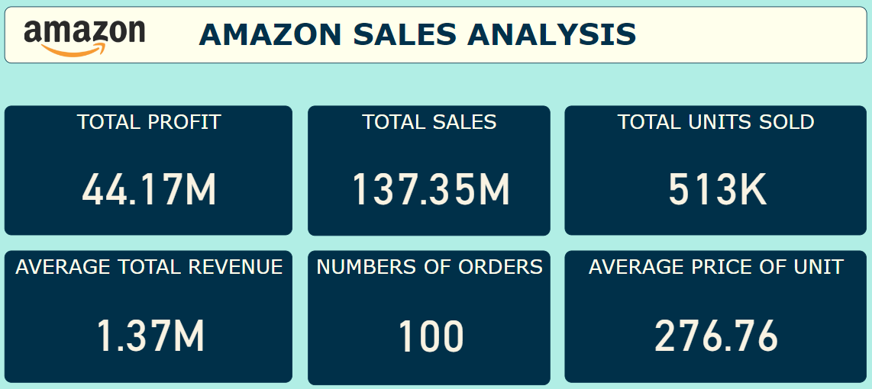
Sales Performance
Total Profit: $44.17 million
Total Sales: $137.35 million
Total Units Sold: 513,000 units
Average Total Revenue: $1.37 million
Number of Orders: 100
Average Price of Unit: $276.76
03

Slide 4
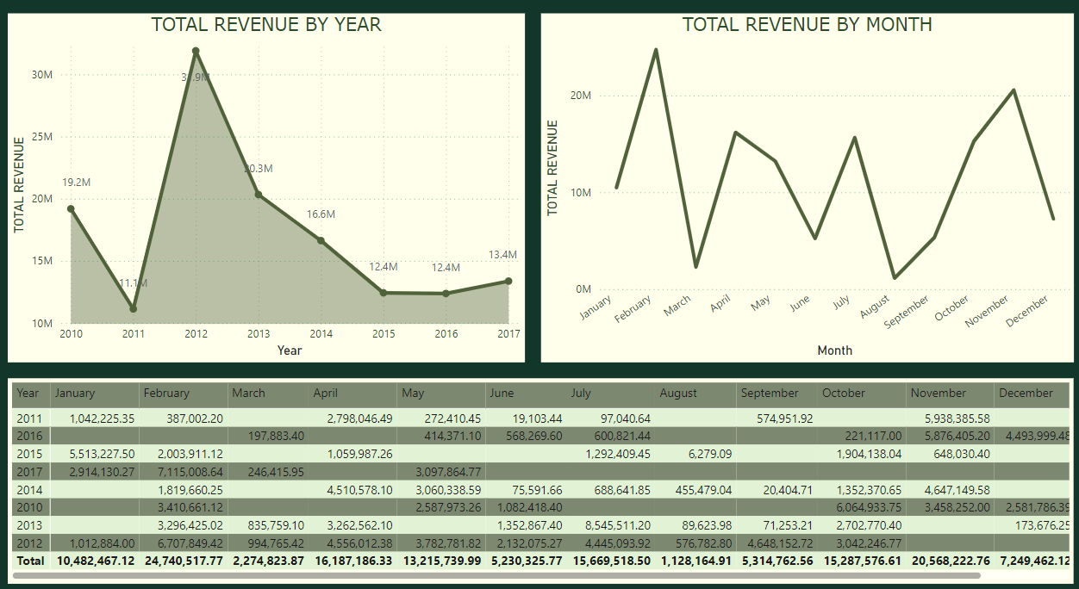
Amazon's total revenue by year from 2010 to 2017
Yearly Revenue Analysis
2011: Revenue decreased to $11.1 million from $19.2 million in 2010.
2012: Revenue peaked at $31.9 million.
2013-2016: Revenue showed a declining trend, stabilizing around $12.4 million.
2017: Slight increase to $13.4 million.
04

Slide 5
Monthly Revenue Analysis
Amazon's total revenue by month
Peak Revenue: Observed in November, indicating strong sales during the holiday season.
Significant Drops: Notable dips in February and April.
Overall Pattern: A cyclical pattern with fluctuations throughout the year, highlighting the impact of seasonal sales.
05

Slide 6
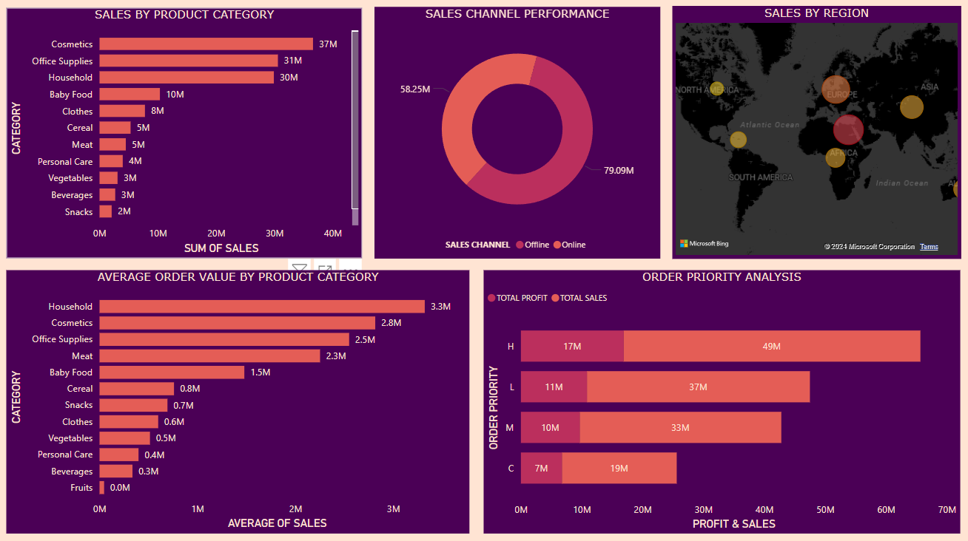
Product Category Analysis
06
Top Categories by Average Order Value:
Household: $3.3 million
Cosmetics: $2.8 million
Office Supplies: $2.5 million
Top Categories by Sales:
Cosmetics: $37 million
Office Supplies: $31 million
Household: $30 million

Slide 7
Sales Channel and Regional Performance
07
Sales Channel Performance:
Online Sales: $79.09 million
Offline Sales: $58.25 million
Sales by Region:
Europe: Highest sales region
North America, Asia, Africa: Other significant regions

Slide 8
Order Priority Analysis
H:
Total Profit: $17 million
Total Sales: $49 million
L:
Total Profit: $11 million
Total Sales: $37 million
M:
Total Profit: $10 million
Total Sales: $33 million
C:
Total Profit: $7 million
Total Sales: $19 million
08

Slide 9
09
THANK YOU

